Slide 1
XML Serialization/Deserialization Technique
Jesse Lynn-Bailey

Slide 2
Why?
Simplifies the process of binding of XML data to C# objects
.NET’s XMLSerializer handles the generic binding of attributes under the hood
Codebase is simplified because a single deserialization/serialization method is used
Allows for bidirectional serialization or deserialization
Can output an XML file or C# object for processing
Code becomes more cohesive by abstracting complexity
Deserialization respects types. Output object properties will not all be strings.

Slide 3
The Process
Select subsection of the original xml using an xpath
Create a new XML subdocument that models that selection(A subtree of the original xml)
Create a model that corresponds to selected subsection
Process the model and subtree using the XmlSerializer.Deserialize() method that turns the subsection into a usable C# object
Why create a new xml subtree from the original?
It allows you to assign meta data in the form of attributes to newly constructed tree nodes.
Allows us to provide additional information about a node without changing the original.
Simplifies the modeling process because we don’t have to model an entire xml. We only have to model the subsection of an XML that were interested in.

Slide 4
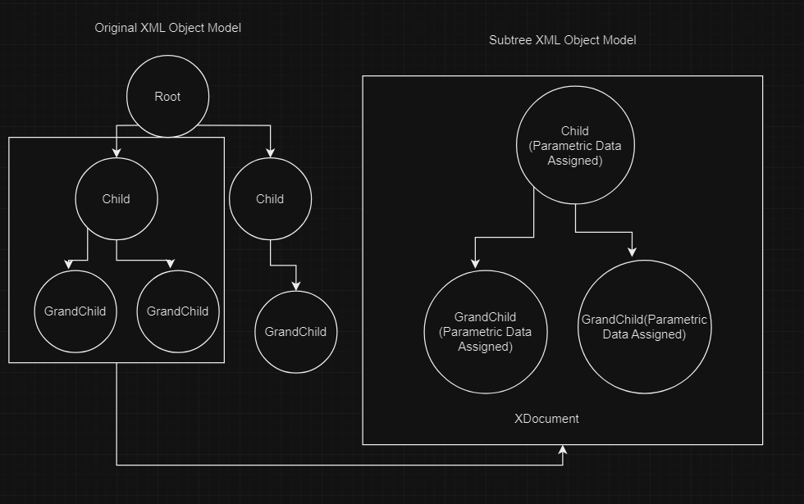

Slide 5
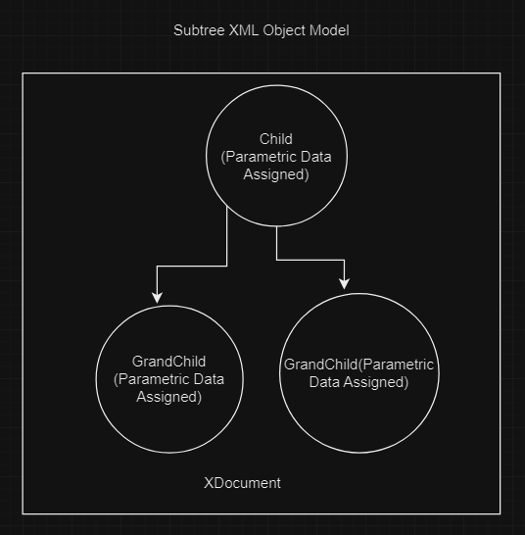
ORIGINAL SUBTREE BEFORE
<Order>
<CustomerID>GREAL</CustomerID>
<EmployeeID>6</EmployeeID>
<OrderDate>1997-05-06T00:00:00</OrderDate>
<RequiredDate>1997-05-20T00:00:00</RequiredDate>
<ShipInfo ShippedDate="1997-05-09T00:00:00">
<ShipVia>2</ShipVia>
<Freight>3.35</Freight>
<ShipName>Great Lakes Food Market</ShipName>
<ShipAddress>2732 Baker Blvd.</ShipAddress>
<ShipCity>Eugene</ShipCity>
<ShipRegion>OR</ShipRegion>
<ShipPostalCode>97403</ShipPostalCode>
<ShipCountry>USA</ShipCountry>
</ShipInfo>
</Order>
NEW SUBTREE AFTER
<OrderCollection>
<Array>
<Order>
<CustomerID>GREAL</CustomerID>
<EmployeeID>6</EmployeeID>
<OrderDate>1997-05-06T00:00:00</OrderDate>
<RequiredDate>1997-05-20T00:00:00</RequiredDate>
<ShipInfo ShippedDate="1997-05-09T00:00:00">
<ShipVia>2</ShipVia>
<Freight>3.35</Freight>
<ShipName>Great Lakes Food Market</ShipName>
<ShipAddress>2732 Baker Blvd.</ShipAddress>
<ShipCity>Eugene</ShipCity>
<ShipRegion>OR</ShipRegion>
<ShipPostalCode>97403</ShipPostalCode>
<ShipCountry>USA</ShipCountry>
</ShipInfo>
<Parametric Index="1" Sequence="10" Group="gOrder" XPath="Root/Orders/Order" />
</Order>
<Order>
…Continues
A new Parametric element is added to the subtree along with attributes

Slide 6
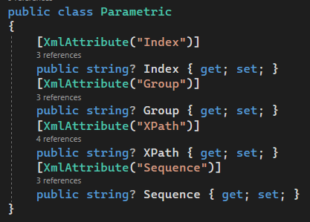
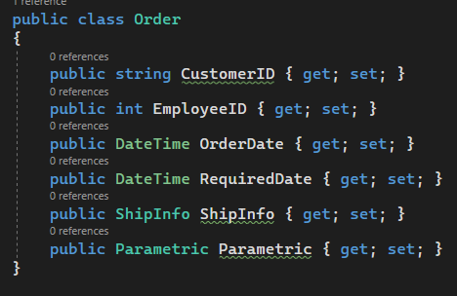
Create A Model From The XML Subtree Obtained From The Original XML Tree
Using C# Classes and Attributes

Slide 7
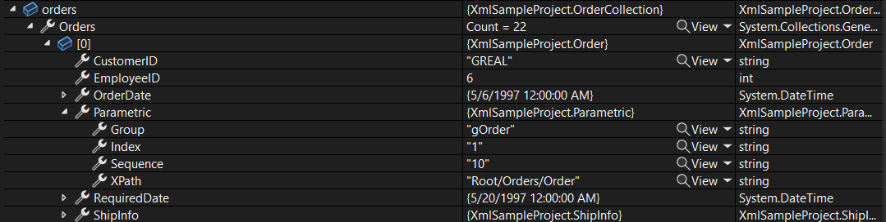
XmlSerializer.Deserialize()

Slide 8
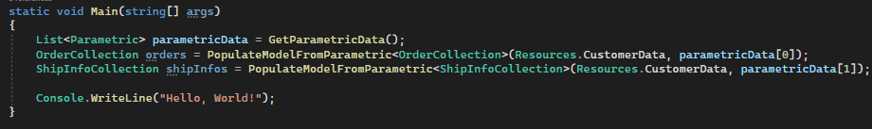
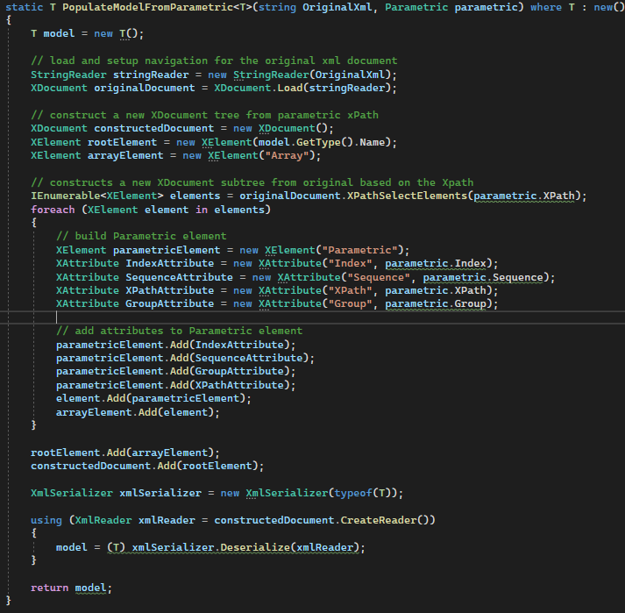
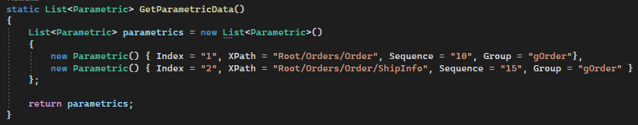
Reusable!!!!

